Slide 1
Clustering Report
alpha
2026-01-08 11:48:51
giovanni.delibra@uniroma1.it

Slide 2
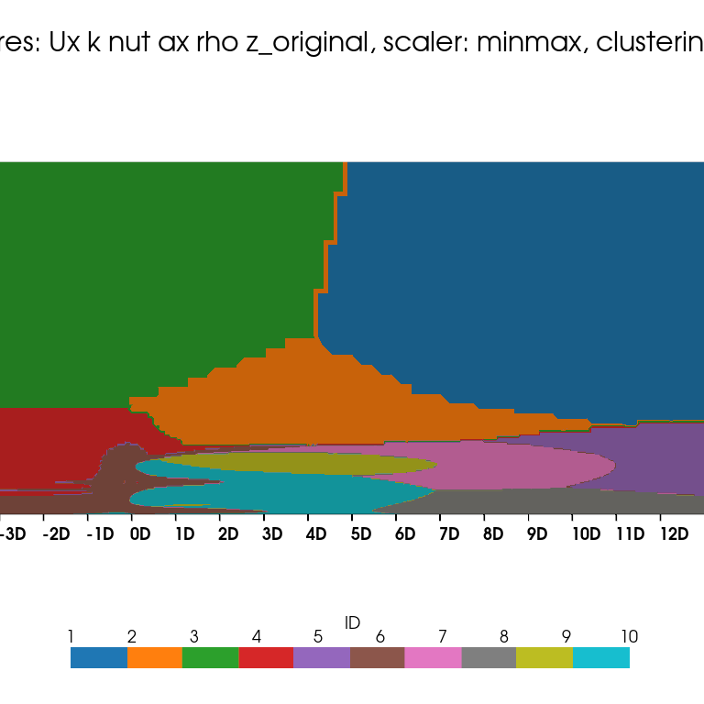
NC = 10time_0
giovanni.delibra@uniroma1.it

